Slide 1
Dissertation plan
Get an idea of what its gonna look like before I start

Slide 2
What I have
Genomes and metadata on NCBI
Previous code from Y2
Annotations on NCBI
10 samples from Bangor, more pending (maybe use, maybe not)
Existing title (Functional variation among bacterial taxa within host-associated microbiomes)

Slide 3
hypothesis
Previously stated Aims
Aim 1: determine whether bacterial genera living on or in different hosts have different genomic functional capacities. (bacterial species/genera adapt to their host)
Aim 2: determine whether different bacterial taxa (genera or families) differ in their predicted functional capacity independent of their host environment. (the adapt to other factors than host)
Hypothesis idea 1
Do bacterial species and genera significantly differ in gene function based on host environment or other factors such as evolutionary history or geographic location? I expect that all of these variables will have an effect on what genes are majorly represented in a species or genus.
Hypothesis idea 2
Do bacterial species and genera significantly differ in gene function, beyond what would be expected from evolutionary history alone, such as by host environment or geographic location? Yes, I expect they adapt

Slide 4
Hypothesis – more ideas
Do bacteria that have known effects as part of the microbiome of one species exhibit different traits when found in the microbiome of another species that is exposed to different pressures or a different environment?
Do bacterial species adapt to pathogen pressures in their hosts?
It all just feels too small, maybe I need to do some reading around to get some better ideas

Slide 5
Bigger ideas – likely too big
A review on how different bacterial species change to benefit their host when found in a host-associated microbiome, compared with their potential roles in the environment
Continuing last year: how 10 bacterial isolates interact in the host-associated microbiome they were sampled from, understanding their environmental function and interplay from their genetic dissimilarities.

Slide 6
More ideas
Pan-genomics: illuminating the pan-genome for [bacterial species(plural?)], the core genes shared by all serotypes and those that flux based on host-environment or geographic location.

Slide 7
Which bacteria to start with?
Compare species within a genus with each other
(once beyond family level any differences due to env or host likely drowned out by evolutionary distance, so keeping at the genus level good)
Genus wants to be well studied, with plentiful samples from hosts across phyla and orders, from all around the world.
E. coli?

Slide 8
Major problems (1)
Problem 1: very, very few samples (for the bacterial species I have looked at so far) have decent host information, and very few of them have non-plant hosts.
Potential solutions 1: Maybe the genera I have looked at are pooly studied and there are more common lineages that have a wider variety of information / Maybe I will end up having to group samples by just host because combining by host and species will be too hard, though that might get odd.
Next steps 1: look at the NCBI website for more common genera, like maybe it would be good to start with E. coli because it is very common, find the host info, which will involve downloading all the metadata and then querying the host info.

Slide 9
Major problems (2)
Problem 2: obtaining the KEGG pathways at scale is very manual and difficult, even with the semi-automated approach used in Y2. It takes a long time and takes a lot of resources on Hawk.
Potential Solutions 2: make use of the annotations already done on the NCBI website to map to KEGG pathways (Claude.ai has suggested this is possible, so we’ll have to see).
Next steps 2: investigate the annotation section that exists for many online samples, see if it can be used to shortcut the annotation process.

Slide 10
Major Problems (3)
Problem 3: There is an acceptable amount of decent host information, as I concluded from answering MP1. However, this information is not acceptably distributed between taxa. Specifically, there is usually next to no amphibian or reptile hosts in the genera I have studied previously. Finding genera that have more even and diverse host information would be ideal for study, so that a wider range of hosts can be studied, which will improve analysis. In summary, the answer to MP1 was getting more annotations of the same genera. However, this does not answer the new problem that creates of (what if the amount of reptile and amphibian hosts does not improve to within acceptable margins?)
Potential solutions 3: I may need fresh genera that have been previously studied in more diverse hosts. just read and look around for more bacterial genera to try
Next steps 3: Once the pipeline is up and major problem 2 is answerd, just keep trying genera until I hit one with a diverse host-set. Look into FTP (File Transfer Protocol) NCBI site. It has zip files on /biosample/biosample_set which may prove useful, and may require linux or python tools to properly explore.

Slide 11
MP3 continued
next steps: test whether adding more data improves the proportions etc, but that needs to be after MP2, specifically for reps, so that is MP3 (so a comparison of the old dataset with the new dataset, that could get convoluted…)
How I do MP3 is based on the results of MP1 and 2. Maybe I just need more data, maybe I need new genera. I remember for 1 genera or other I may be maxed out and have all the accessions already
Perhaps I will have to live with a lack of info for herps
The more I think about this the more I think it is the same as MP1, but can only be fixed after MP2 and this thing with the herps is just a by-product

Slide 12
Minor problems
Host info is freetext, so will need to be messed with so it can be used, at scale mapping things like “homo sapien = mammal” and “human = homo sapien” wants to be automated. This may just be something that has to be brute forced.
Need to decide on format I want to write the dissertation in, as all of these problems are likely going to be Chapter 1, so I want to be writing it up as I go.
My choice at the moment is between Quarto book and Quarto manuscript.
The whole GCF / GCA debaucle

Slide 13
More problems (?)

Slide 14
First steps – answer major problem 1
Characterise host information currently held
I have host info, I don’t think it looks good, but I don’t have anything else to compare it against, no metrics.
Load metadata into SQL database for query,
Manually categorise host information, because I cant think of a better way
Produce some tables / a dashboard for information like “how many samples have hosts?”, “how many hosts are animal?”, “how many classes are represented?”
This will give me metrics that I can compare new data with to help me see if new genera are improvements.
Find good looking genus, I think the best to start with is E. coli
Perform the same analysis described above and compare the metrics
If it isn’t better, look for the genus with the most samples on NCBI and try some more until a good one is found.
If E. coli is the one, then I hit problem 2, how do I get all the KEGG pathways in a non-painful manner

Slide 15
First steps – answer major problem 2
I have the annotated protein fastas from EggNOG-mapper for my samples taken last year.
I can compare this KEGG information with KEGG information derived from whatever weird shortcut route Claude.ai helps me go down.
If this demonstrates good similarity in results, I can use this hopefully much faster method to obtain KEGG pathway information for the genus selected in Major Problem 1
If it does not, likely EggNOG-mapper is the only viable solution and I will have to accept that the process will be grueling.

Slide 16
What I want the outputs to look like
What is needed to answer the hypothesis?
Do bacterial species and genera significantly differ in gene function, beyond what would be expected from evolutionary history alone, such as by host environment or geographic location? Yes, I expect they adapt
Visuals to display results
Show trends where there are functional differences where there are correlations with different hosts or geographies
Like with geography or host
Also, need data of just evolution and phylogeny to compare against, so I can see if a change is by the factor, or just through evo differences.
Possibly more phylo trees, a heatmap just for evo diffs, like the one from Y2
Maybe give this data its own dashboard
Maybe like a database of all the differences, some way to compare all the differences found in the heatmaps. Run different queries on the same subjects. Some final way of combining the data from the three sources into one comparison.

Slide 17
visuals
Heatmap of host against KEGG-pathway
Colour is based on number of samples which contain that KEGG pathway with that host
Brighter colours = more proportional samples with mammalian hosts have that pathway than is seen in fish, thus I conclude it is an adaptation to mammalian skin etc
Heatmap of geography against KEGG-pathway
Colour is based on number of samples which contain that KEGG pathway for that region
Brighter colours = more proportional samples in NA than SA, thus I conclude it is an adaptation to NA etc
This relates to how I want to do dashboards for both of these variables with more metadata on these and user-driven engagement stuff

Slide 18
Other outputs
Comparison of samples with hosts or specific hosts vs env samples for a genus, or just include “environmental” as a host in the heatmap.

Slide 19
Hypothesis: Do bacterial species and genera significantly differ in gene function, beyond what would be expected from evolutionary history alone, such as by host environment or geographic location?
“findings indicate that there is significant differences between groups based on host or geography”
Test hypothesis
How?

Slide 20
Comparisons between genera or species to see how they differ purely evolutionarily.
Test hypothesis
Source of gene functions, the NCBI website. These will need to be gathered or created one way or another to see how a species could adapt to the host
Information on host. This will need to be grouped so as to act as categories for the aforementioned gene function
Information on geography. This will need to be grouped so as to act as categories for the aforementioned gene function

Slide 21




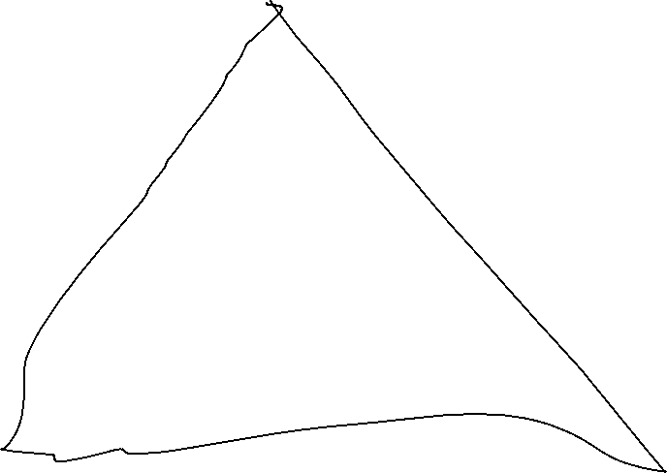






Slide 22





